Slide 1

MediClip
Francois Janse van Vuren
Karl Foley
Jacobus Janse van Vuren

Slide 2
What is MediClip?
MediClip is essentially a virtual clipboard
MediClip will assist nurses when performing their daily tasks by simplifying patient paperwork
MediClip will be available on both Android and iOS

Slide 3
Main Features
Access patient information without the hassle of having to find the correct documents or searching through file cabinets
View a patients current dosage information
Perform a routine check on the patients condition
Add notes on a patient, including photos

Slide 4
Mobile Features
Utilise the phones camera functionality to allow users to add photos to their notes
Shake to clear functionality. Allowing users to clear text fields by shaking the phone (Only for text fields they are currently editing)
Notifications on when a patients medication is due

Slide 5
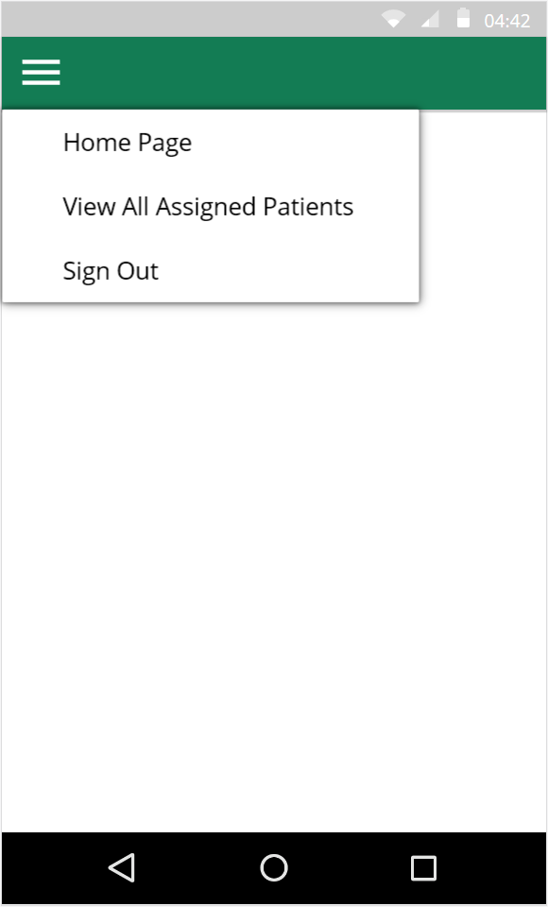
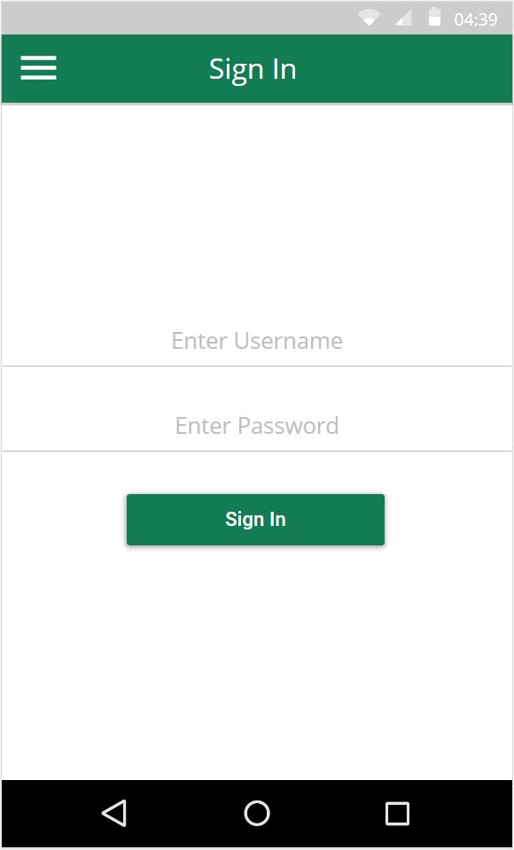
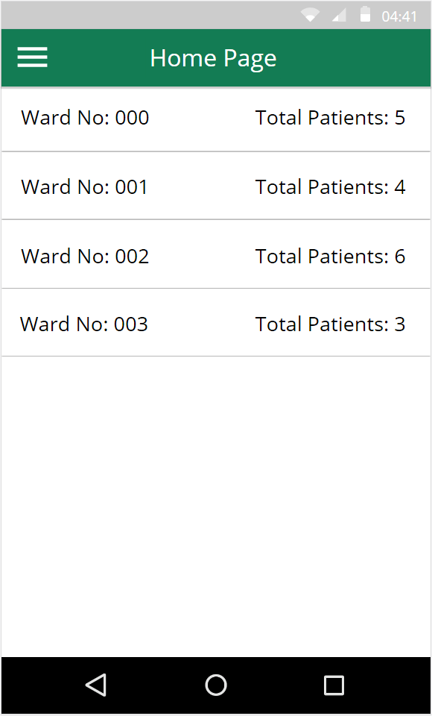
User Interface
Menu available from all screens
Back button provided
by Android OS
Tap to view patients
In ward
Notes:
For the MediClip user interface, there will be a persistent toolbar at the top containing a page title and a hamburger menu. This menu consists of a list of links such as to the home page, view all assigned patients and a sign out option. The first page the user sees is the sign in page. This takes them to the home page where there is a list of all their assigned wards. When the user taps on one of the wards it takes them to a list of patients.

Slide 6
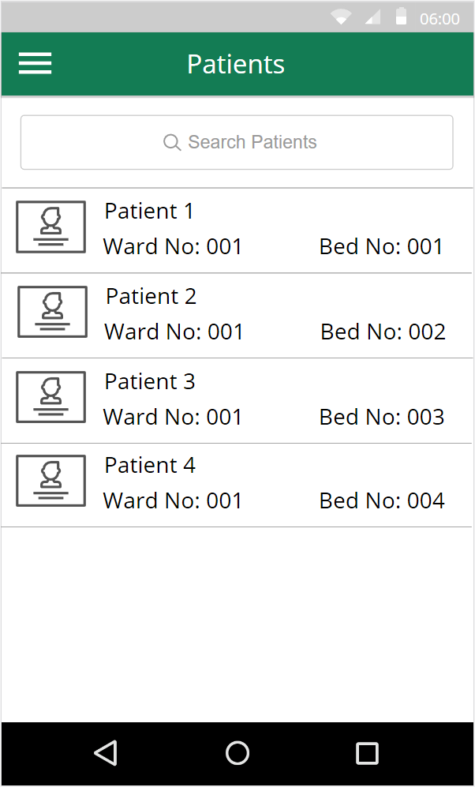
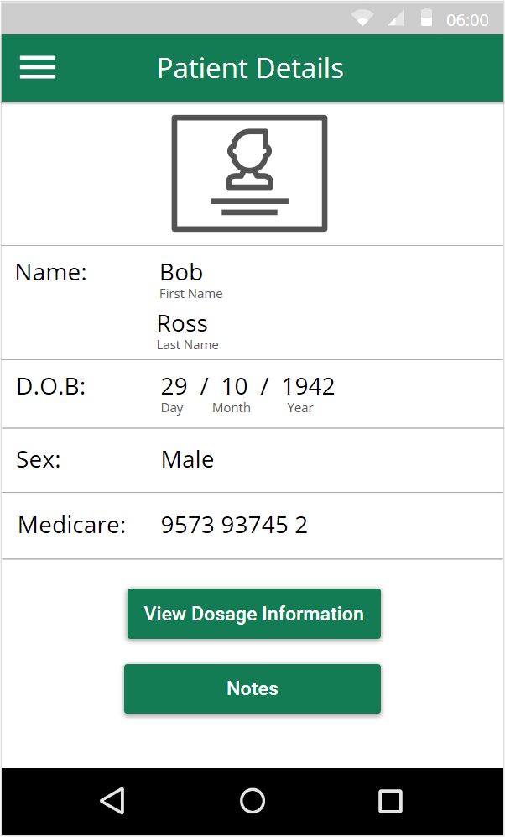
User Interface
Displayed as message
box
Tap to view patient details
Notes:
This list of patients will have search functionality. You are able to search by patient name and bed number. When the user taps on one of the patients they are presented with the patient details. This contains useful information such as the patients dosage information and notes. When the user taps on the notes button it takes them to a list of patient notes.

Slide 7
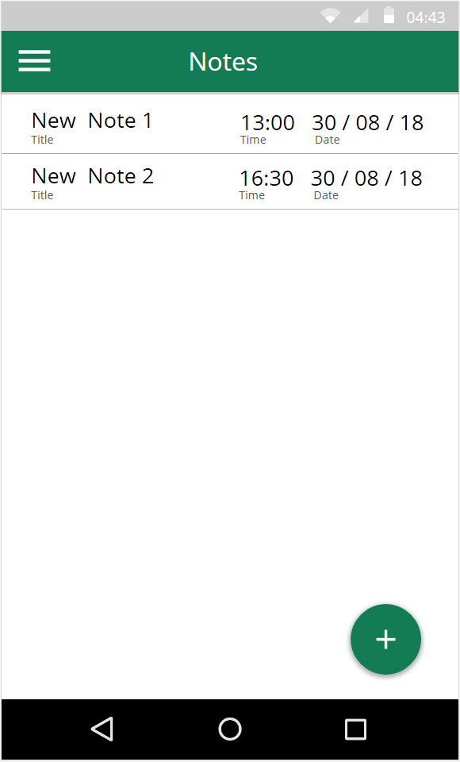
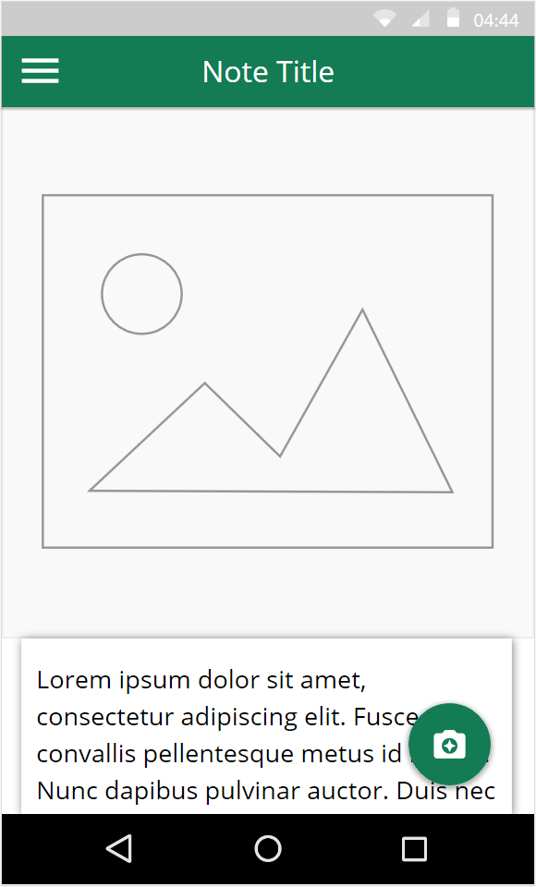
User Interface
Tap to view/edit note
Scroll down to
see text
Add photo to
note
Shake to clear text
Tap on text box to edit
Add new note
Notes:
On this page the user has the ability to view and edit notes and also create new notes. When creating or editing a note they will have the option to add a photo using the camera. When writing text they can shake the phone to quickly erase all the text. That’s all for the UI.

Slide 8
Research
Data Storage —in a form of a SQL Server — Week 3
Search functionality — Using SQL inside a app
Network connectivity — Week 8 & week 9
Camera — Week 5
Accelerometer — Week 5
Notifications

Slide 9
Why? Case Study – John Hunter Hospital
Admissions
80,000 patients a year
40,700 non-emergency patients
29,800 emergency patients
Current Systems
Computer based client patient management system
Drug management distribution system
Patient status reports done in paper
Patient status reports differ between wards.

Slide 10
Thank you for listening!

